Slide 1
Nawy Dataset

Slide 2
Data Exploration
Data consists of 91129 rows and 11 columns.
No Duplications between rows.
Missing data around 2% of all data.
There’s an imbalance between classes

Slide 3
Exploratory Data Analysis

Slide 4
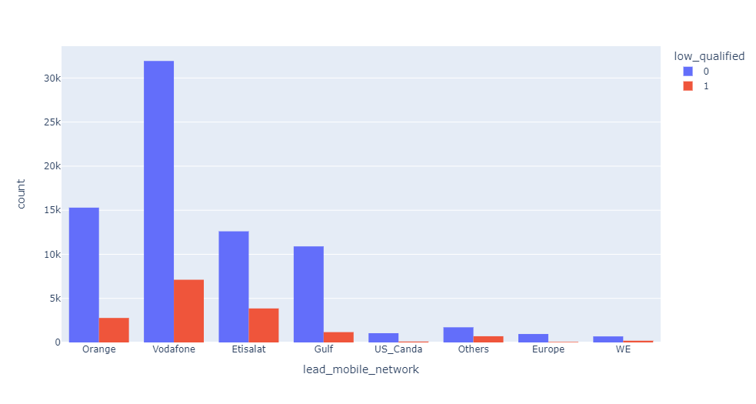
Check for type of Mobile Network
Most Network used if Qualified or Not is Vodafone

Slide 5
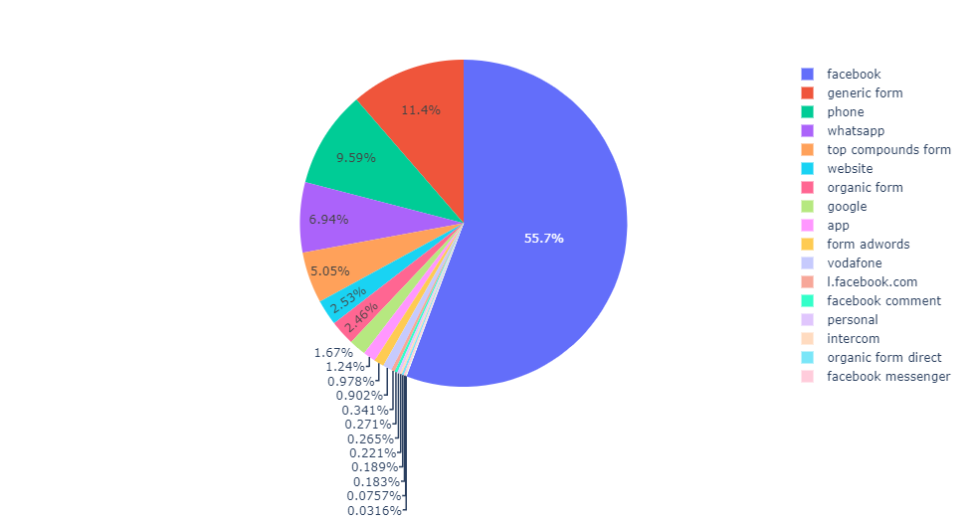
Method Of Contact
Facebook is the Most method used by Customers

Slide 6
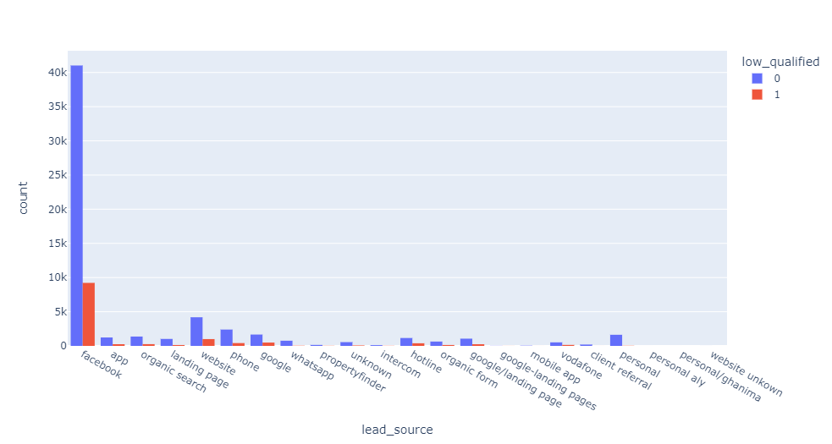
Lead Source
Also Facebook is Most Lead Source by Customers

Slide 7
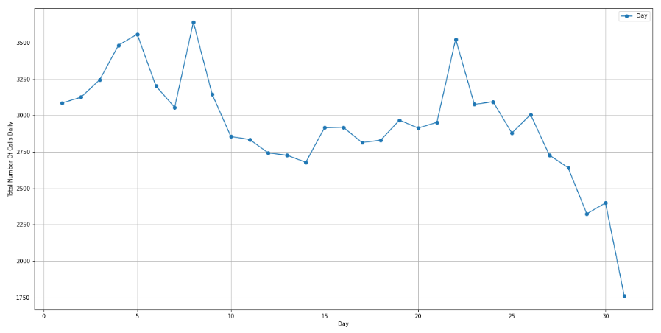
Lead Time Analysis
Total Number Of Call happens Daily.
Most of call occur between day 5 to day 10 and day 22 each Month

Slide 8
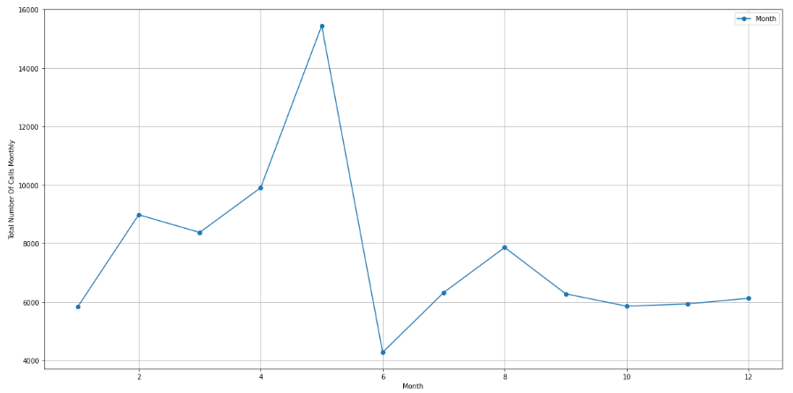
Lead Time Analysis
Total Number Of Call happens Monthly
May is the Highest

Slide 9
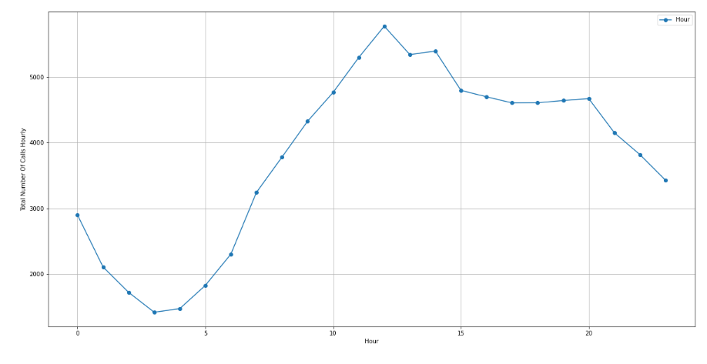
Lead Time Analysis
Total Number Of Call happens Hourly
From 11 Am to 2 pm is Highest Calls

Slide 10
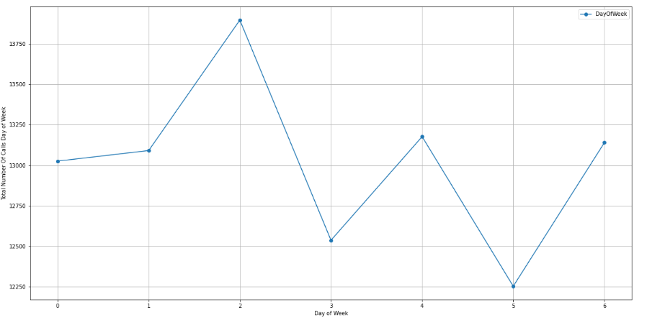
Lead Time Analysis
Total Number Of Call happens in Each Day of Week

Slide 11
Lead Time Analysis
This time analysis can help us to focus on the Rush Days and also Rush Hours in order to Deliver best information for customers according to their inquires

Slide 12
Feature Engineering.
Due to small percentage of NAN values , it’s can be drop.
Use Word cloud to see Frequent words in Message columns
Then Used sentiment analysis to analyze the Message column for Positive and Negative and Neutral response.
Make ordinal encoding for ad group , campaign , location according to their frequency in data.
Tried both Ordinal encoding for mobile Networks and Also one hot encoding.

Slide 13
Feature Engineering.
The main problem was Imbalance dataset.
1st I tried Up sample using SMOTE but most of models underfit this data.
2nd I tried down sample , models perform better than Up sample. But not overall good performance.
For Feature Selection , I used RFE with Random Forest Model and Also Manual Feature selection.

Slide 14
Metrics
I assumed that the Metric should I evaluate on is Recall Metric.
Because we are interested in Qualified customer ( 1 ) , so I’m afraid that model say on Qualified Customer 0 but It’s 1 , So False Negative

Slide 15
Models
Logistic Regression
Random Forest
Decision Tree
KNN
SVC
XGB Classifier

